Slide 1
RVAPT - 0
Introduction and Plans

Slide 2
Sign-In!!!
signin.rvapt.ritsec.club

Slide 3
Thanks for coming! Here’s the RVAPT Flag!
RS{HACK_OUTSIDE_THE_BOX}

Slide 4
Agenda
Whoami
What is RVAPT
Goal of RVAPT
Semester Plan
What is Penetration Testing?
RVAPT & CTPC
Skill Assessment
Skill Assessment 2 - Technical (Demo)

Slide 5
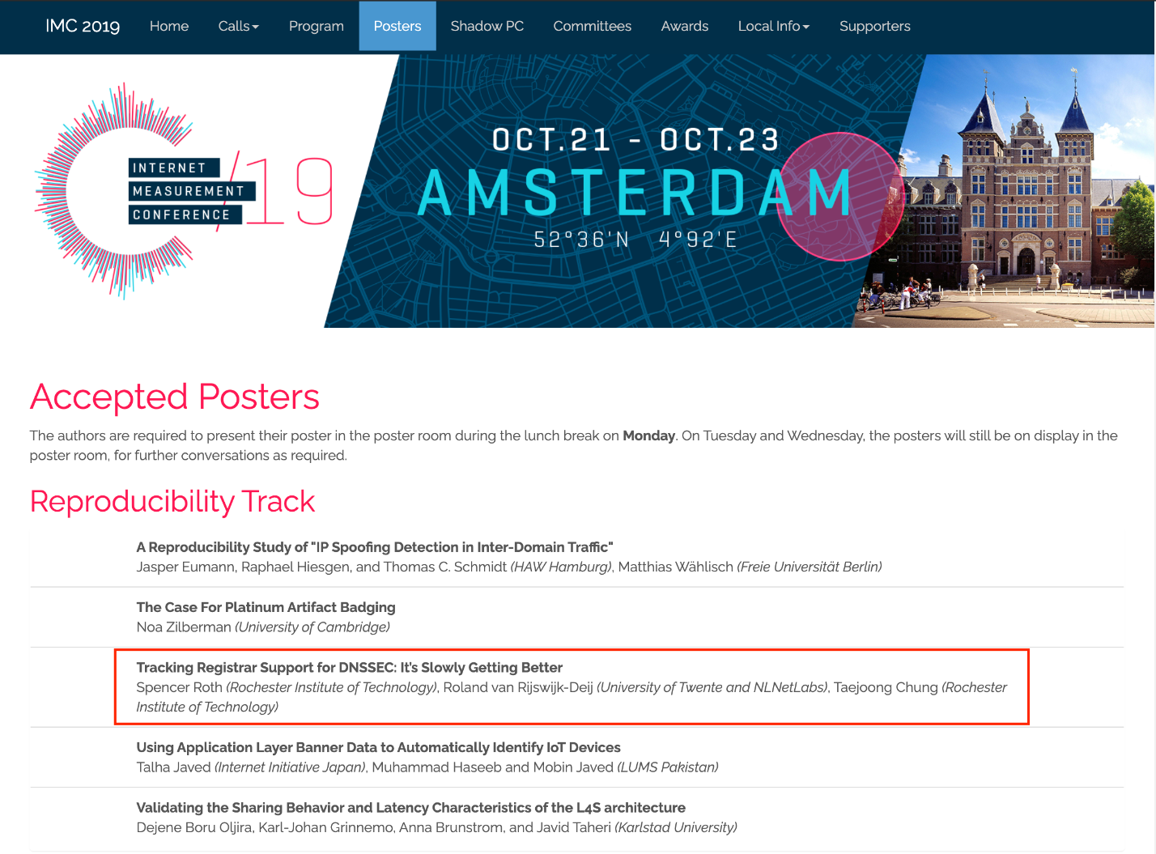



Whoami - Spencer Roth
Former RITSEC Treasurer
3.5 Year BS/MS
Internet Measurement Research Background: Publication at ACM IMC
Offensive Security Experience
Current Interests: Penetration Testing, Red teaming, IoT, Mobile, WebApp

Slide 6
What is RVAPT?
RIT Vulnerability Assessment and Penetration Testing
Started by Ben Bornholm
Focus on Offensive Security
“Professional Devil’s Advocate” - Prof. Olson
Vulnerability Assessment
Penetration Testing
Red Teaming

Slide 7
Goal of RVAPT

Slide 8
Goal of RVAPT
Understanding Offensive Security
Offensive Mindset
Technical
Target → Proactive Research + (Suffering) → Unintended Behavior
Methodology
Non-Technical
Provide Value
Professionalism
Technical Writing
Become a “proper” Offensive Security oriented student/professional

Slide 9

Semester Plan
Focus on Penetration Testing
PTES - Penetration Testing Execution Standard
Penetration Testing 7 steps
Modified version
Red Teaming
30 min Presentation + 30 min Lab
(Hopefully) Mini-Competition
Full Penetration Testing against a simulated company
Notes:
Pre-engagement, Recon, Threat modeling(no), Vulnerability analysis, Exploitation, Post-exploitation, Reporting
Mohad from here

Slide 10
What is Penetration Testing?
Security audit where testers attempt to find and exploit vulnerabilities in a target
2++ individuals → Find vulnerabilities → “Hack” target → Report
“Find weakness before the bad guys do”
“Is XYZ actually implemented? Is it implemented the way it should be?”
Goal = Better security, marketing, compliance
Notes:
modsecurity

Slide 11
How is it different than Vulnerability Assessment?
A vulnerability assessment only focuses on discovery of possible vulnerabilities/bugs
A pentest includes actually exploiting the vulnerabilities discovered to determine business impact across an entire system
Notes:
modsecurity

Slide 12
How is it different than Red Teaming?
Red teaming: Similar to a pentest, but more actual hackery
Focus is on stealth and full compromise
Find vulnerability → Exploit vuln → Escalate Privs/Lateral Movement
LIKE A NINJA
Notes:
modsecurity

Slide 13
Topics
Pre-Engagement
Reconnaissance
Passive (OSINT)
Active
Exploitation
Post-Exploitation
Priv.Esc
Lateral Movement
Reporting
Red Team - Persistence
Mini Competition

Slide 14
RVAPT & CPTC
Collegiate Penetration Testing Competition
Simulated Penetration Testing - Full Experience
Fun + Lessons + Networking + Jobs
Prepare for CPTC experience

Slide 15
Questions?

Slide 16
Skill Assessment
Notes:
How many people attended RVAPT last semester
Experience with any type/kind of Offensive Security activity
Tutorial, hackthebox, using security tools, vulnhub, wargames, certifications
Experience with following tools
Nmap,

Slide 17
Skill Assessment 2 - Technical
Notes:
Register to Hackthebox
Automate the process
import requests
import time
import json
import base64
import codecs
howtoURL = "https://www.hackthebox.eu/api/invite/how/to/generate"
generate = "https://hackthebox.eu/api/invite/generate"
headers = {'accept': 'application/json text/javascript', 'user-agent':'Mozilla/5.0 (Windows NT 10.0; Win64; x64) AppleWebKit/537.36 (KHTML, like Gecko) Chrome/79.0.3945.88 Safari/537.36'}
res = requests.post(howtoURL,headers=headers)
json_data = json.loads(res.text)
message = json_data['data']['data']
enctype = json_data['data']['enctype']
print("[DEBUG] message = ", message)
print("[DEBUG] encoding = ", enctype)
if enctype == "BASE64":
decoded = base64.b64decode(message)
print(decoded)
else:
decoded = codecs.encode(message, 'rot13')
print(decoded)

